Slide 1
Recurrent Neural Networks (RNNs)
Deep Learning
Notes:
Introduction to the presentation on Recurrent Neural Networks (RNNs).

Slide 2
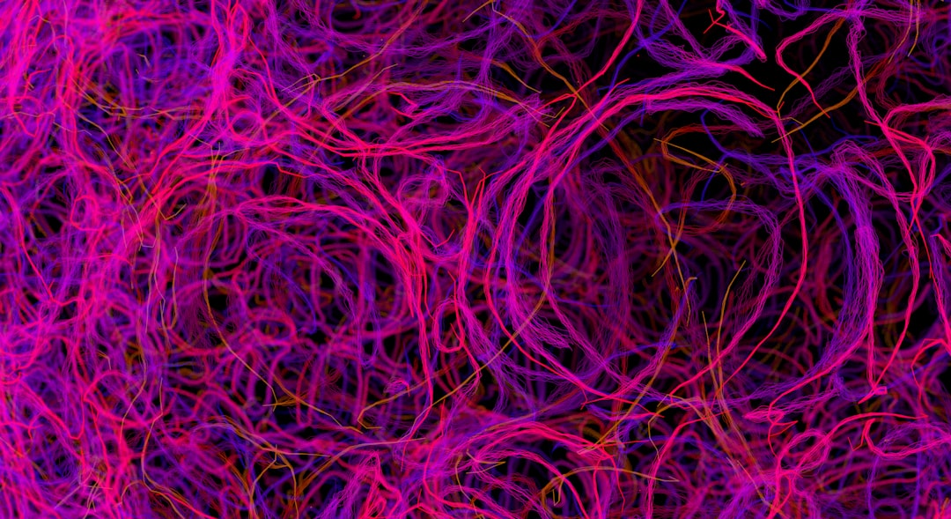
Introduction
Recurrent Neural Networks (RNNs) are neural networks with feedback
RNNs are used for sequential data like time series or speech
RNNs can learn long-term dependencies in data
RNNs are a type of deep learning model
RNNs are widely used in natural language processing
RNNs can be used for prediction and classification tasks
RNNs are trained using backpropagation through time
RNNs have many applications in real-world problems
RNNs can learn complex patterns in data
RNNs are a fundamental concept in deep learning
Notes:
Introduce the concept of RNNs, explain their importance in deep learning, and provide examples of their applications. Ask students if they have heard of RNNs before and what they know about them. Summarize the key points of the slide and preview the next slide.

Slide 3
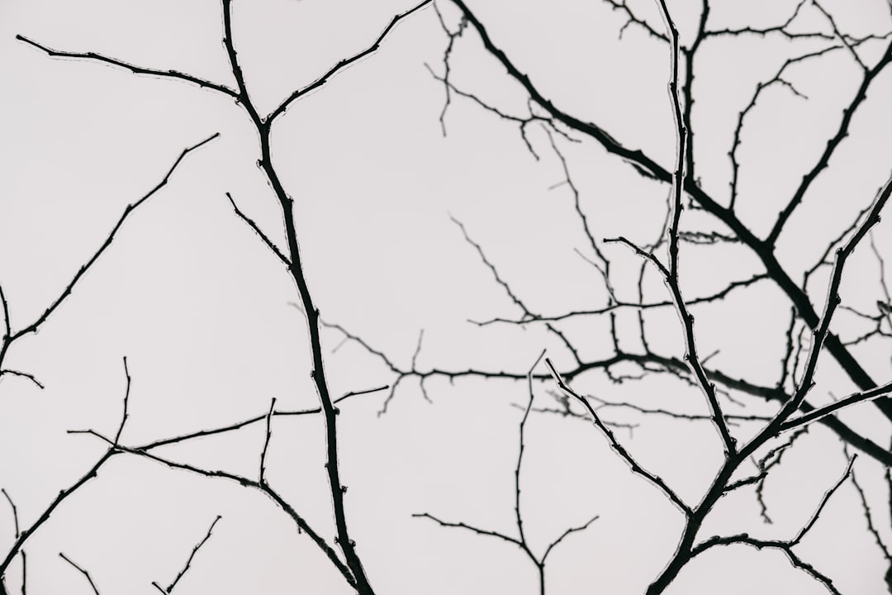
Architecture
RNNs consist of input, hidden, and output layers
RNNs have recurrent connections between hidden layers
RNNs use activation functions like sigmoid or tanh
RNNs can be unidirectional or bidirectional
RNNs can be used with different optimization algorithms
RNNs can be trained using different loss functions
RNNs can be regularized using dropout or L1/L2
RNNs can be visualized using graph or tree structures
RNNs can be implemented using different programming languages
RNNs can be used with different deep learning frameworks
Notes:
Explain the architecture of RNNs, including the different types of layers and connections. Provide examples of how RNNs can be used with different optimization algorithms and loss functions. Ask students to think about how RNNs can be used in different applications, such as natural language processing or speech recognition.

Slide 4
Mathematical Formulation
RNNs can be formulated using differential equations
RNNs can be represented using matrix notation
RNNs can be trained using gradient descent
RNNs can be optimized using backpropagation
RNNs can be regularized using L1 or L2 regularization
RNNs can be used with different activation functions
RNNs can be used with different loss functions
RNNs can be used with different evaluation metrics
RNNs can be visualized using visualization tools
RNNs can be interpreted using feature importance
Notes:
Explain the mathematical formulation of RNNs, including the use of differential equations and matrix notation. Provide examples of how RNNs can be trained using gradient descent and optimized using backpropagation. Ask students to think about how RNNs can be used in different applications, such as time series forecasting or image classification.

Slide 5
Training and Backpropagation Through Time
RNNs can be trained using backpropagation through time
RNNs can be trained using truncated backpropagation
RNNs can be trained using gradient descent
RNNs can be optimized using Adam or RMSProp
RNNs can be regularized using dropout or L1/L2
RNNs can be used with different batch sizes
RNNs can be used with different sequence lengths
RNNs can be used with different optimization algorithms
RNNs can be visualized using visualization tools
RNNs can be interpreted using feature importance
Notes:
Explain the training process of RNNs, including the use of backpropagation through time and truncated backpropagation. Provide examples of how RNNs can be optimized using different optimization algorithms and regularized using dropout or L1/L2 regularization. Ask students to think about how RNNs can be used in different applications, such as speech recognition or natural language processing.

Slide 6
Applications
RNNs can be used for natural language processing
RNNs can be used for speech recognition
RNNs can be used for time series forecasting
RNNs can be used for image classification
RNNs can be used for sentiment analysis
RNNs can be used for machine translation
RNNs can be used for text summarization
RNNs can be used for chatbots
RNNs can be used for recommender systems
RNNs can be used for anomaly detection
Notes:
Explain the different applications of RNNs, including natural language processing, speech recognition, and time series forecasting. Provide examples of how RNNs can be used in different industries, such as healthcare or finance. Ask students to think about how RNNs can be used in their own projects or research.

Slide 7
Advantages and Limitations
RNNs can learn long-term dependencies
RNNs can handle sequential data
RNNs can be used for prediction and classification
RNNs can be trained using backpropagation
RNNs can be optimized using different algorithms
RNNs can be regularized using dropout or L1/L2
RNNs can be computationally expensive
RNNs can suffer from vanishing gradients
RNNs can be difficult to interpret
RNNs can be sensitive to hyperparameters
Notes:
Summarize the advantages and limitations of RNNs, including their ability to learn long-term dependencies and handle sequential data. Provide examples of how RNNs can be used in different applications, and ask students to think about how RNNs can be improved or extended in the future. Provide a final summary of the key points of the presentation and preview future topics in deep learning.

